Slide 1
TABLES | GRID
U3.L4-
Using the grid for videos and images

Slide 2

DO NOW
Open your Unit 3 Planning document.
Review the calendar
On Google Classroom:
Describe a goal you have for today’s Web Lab Work Time.

Slide 3

Agenda
Do Now
Tables (review)
colspan
Adding Videos (iFrames)
Work Time

Slide 4

Objectives
Create a basic search input box with a search button to create a search bar using the <form> and <input> tag, the action and method attributes.
Understand how to create a form page, by creating a feedback and signup form for a Newsletter using a variety of form controls.

Slide 5
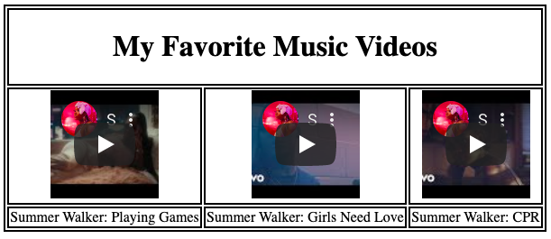
Example - GOALS!

Slide 6
[LIVE DEMO]
Creating a Table With Videos + Images

